Slide 1
Instantaneous Centre of Zero Velocity (ICZV)
Dr. Agnes d’Entremont
Associate Professor of Teaching
Mechanical Engineering, University of British Columbia

Slide 2
Instantaneous Centre of Zero Velocity
For rigid bodies undergoing general plane motion (i.e. translating and rotating), there is often a point about which the body appears to be rotating at a particular instant.
This point is called the instantaneous Centre of Zero Velocity (ICZV).
The ICZV can sometimes be a useful shortcut to solve kinematics problems.

Slide 3
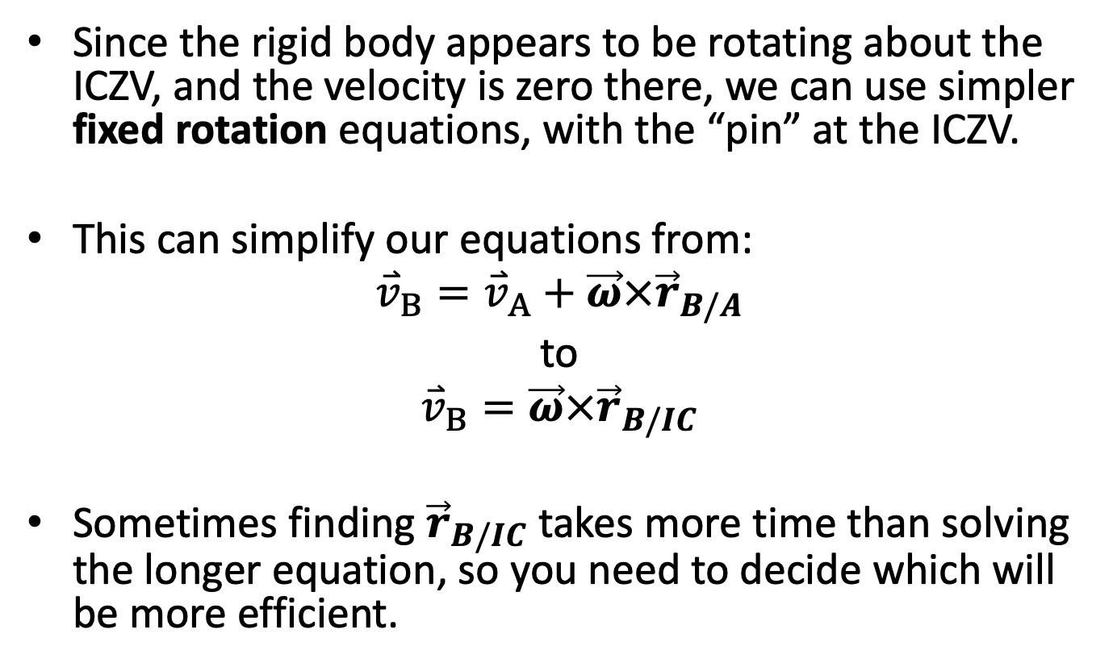
How ICZV is used
Since the rigid body appears to be rotating about the ICZV, and the velocity is zero there, we can use simpler fixed rotation equations, with the “pin” at the ICZV.
This can simplify our equations from:
$${\overset{⃑}{v}}_{B}={\overset{⃑}{v}}_{A}+\vec{ω}×{\vec{r}}_{B/A}$$
to
$${\overset{⃑}{v}}_{B}=\vec{ω}×{\vec{r}}_{B/IC}$$
Sometimes finding ${\vec{r}}_{B/IC}$ takes more time than solving the longer equation, so you need to decide which will be more efficient.

Slide 4





Finding ICZV
ICZV is found graphically.
Find the direction of two velocities on the same body.
Draw lines perpendicular to the velocities.
The point where the lines intersect is the ICZV.
$${\overset{⃑}{v}}_{B}$$
B
$${\overset{⃑}{v}}_{A}$$
A
$$Y$$
ICZV
$$X$$
O
CC BY binocular by iconcheese from the Noun Project

Slide 5
Cautions about ICZV
ICZV is instantaneous. It is only true for this instant, and will typically change location in the next instant.
ICZV is only true (zero) for velocity. It is not a location where acceleration is zero.
ICZV can be off the body. You can imagine there are invisible, massless bars that connect to the instantaneous “pin” for the body.
There can be cases where there is no ICZV (e.g. object isn’t moving, or isn’t rotating).
If the two velocities are parallel, you need additional information beyond the directions of the velocities.

Slide 6






Two parallel velocities = need more information
Draw lines head-to-head and tail-to-tail
There are three cases for two parallel velocities
Parallel, opposite sense
Parallel, same sense
Different magnitudes
Same magnitudes
$${\overset{⃑}{v}}_{A}$$
A
A
$${\overset{⃑}{v}}_{A}$$
A
$${\overset{⃑}{v}}_{A}$$
ICZV
$${\overset{⃑}{v}}_{B}$$
$${\overset{⃑}{v}}_{B}$$
B
B
B
$${\overset{⃑}{v}}_{B}$$
ICZV
No ICZV
(ICZV at infinity)

Slide 7
Suggestions for ICZV
Label which body an ICZV relates to (since it can lie on another body in the problem.
ICZV is especially useful if you know directions without magnitudes (e.g. a point is constrained to a path).
You can very quickly find the direction of velocity of any other point on the rigid body once you have the ICZV.

Slide 8
Thanks for Watching
See other engineering mechanics videos and access the full tool at…

Slide 9
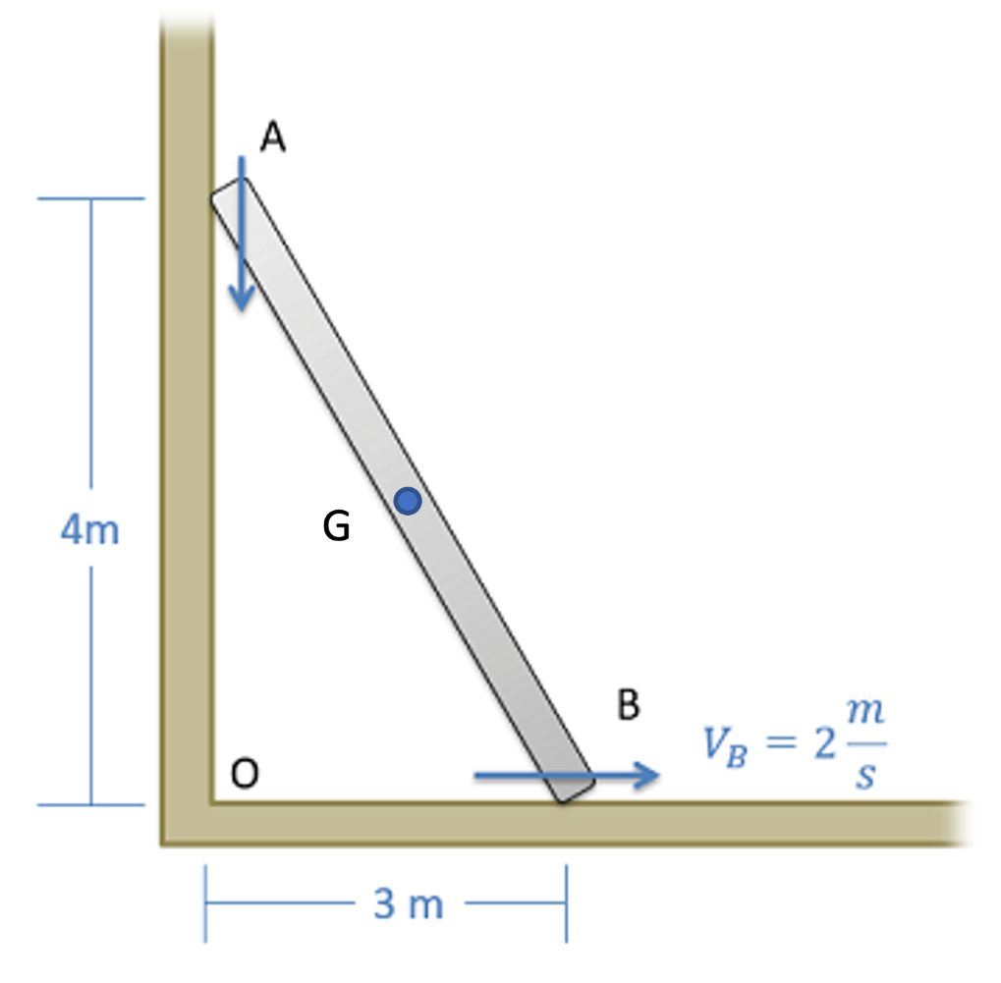
Worked Example
A ladder is propped up against a wall as shown below. If the base of the ladder is sliding out at a speed of 2 m/s, what is the velocity of the center of mass (G) of the ladder (at the mid-point)?

Slide 10
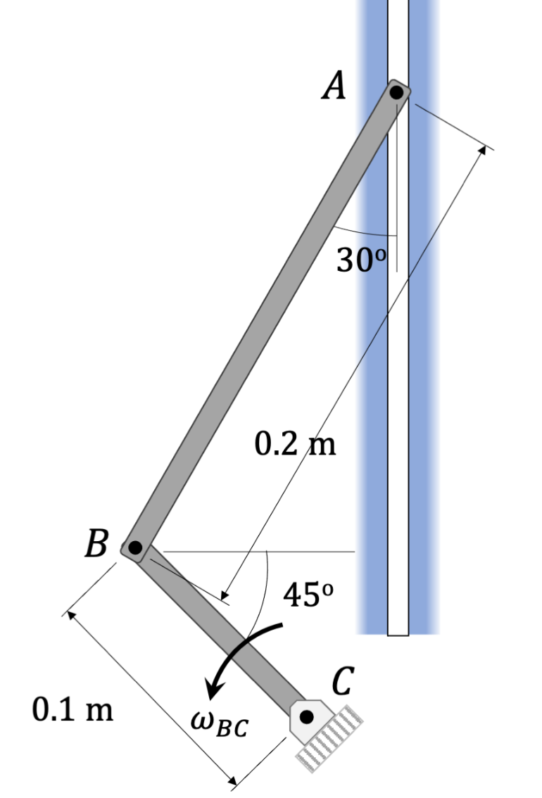
Worked Example
Two rods, AB and BC, are connected and moving. A pin at point A follows the vertical slot shown. Find the ICZV for each rod at the instant shown. If rod BC has an angular velocity of 3 rad/s, find the angular velocity of rod AB.

